Slide 1
Cs2030
Tutorial 7
jeremychoo@u.nus.edu

Slide 2
Question 1: LazyInt
Implement a class LazyInt that encapsulates a lazily evaluated Integer value. A LazyInt is specified by a Supplier, such that when the value of the LazyInt is needed, the Supplier will be evaluated to yield the value. Otherwise, the evaluation is delayed as much as possible.
LazyInt supports the following operations:
• map returns a LazyInt consisting of the results of applying the given function to the value of this LazyInt.
• flatMap returns a LazyInt consisting of the results of replacing the value of this LazyInt with the value of a mapped LazyInt produced by applying the provided mapping function to the value.
• get returns the value of LazyInt.

Slide 3
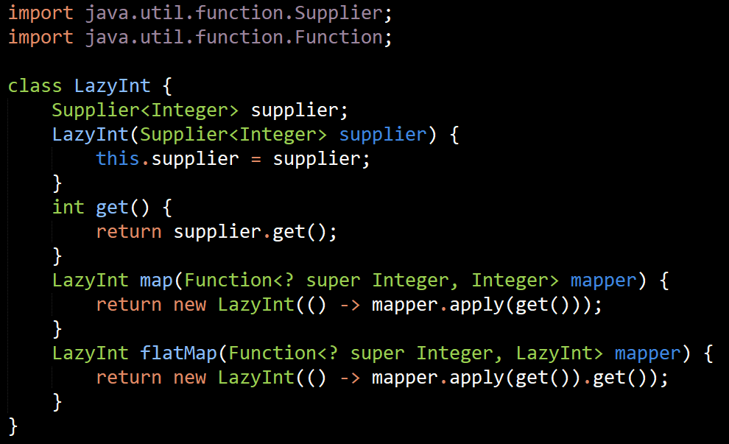

1. LazyInt
What’s wrong with:
return mapper.apply(get()) ?
Notes:
LazyInt map(Function<? super Integer, Integer> mapper) {
return new LazyInt(() -> mapper.apply(get()));
}
LazyInt flatMap(Function<? super Integer, LazyInt> mapper) {
return new LazyInt(() -> mapper.apply(get()).get());
}

Slide 4
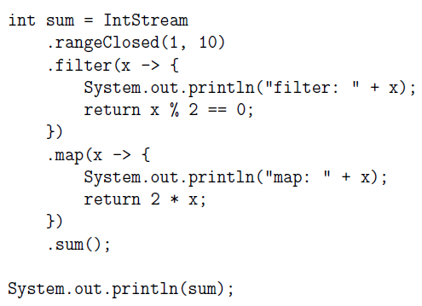
2. Parallelizing streams
filter: 7
filter: 4
filter: 1
filter: 9
filter: 8
filter: 10
filter: 3
filter: 2
filter: 6
map: 8
filter: 5
map: 10
map: 4
map: 6
map: 2
60
filter: 1
filter: 2
map: 2
filter: 3
filter: 4
map: 4
filter: 5
filter: 6
map: 6
filter: 7
filter: 8
map: 8
filter: 9
filter: 10
map: 10
60
The following program fragment was demonstrated during an earlier lecture to illustrate the effect of lazy evaluation in streams.
What is the output of running the sequential stream?
Parallelize the stream by including the appropriate operation and observe the output. What conclusions can you make?
Include the expression Thread.currentThread().getName() into the println statement of the lambda associated with filter and map, and observe the output again. What does the expression do?
.parallel()
It returns the name of the current thread associated with the stream operation.

Slide 5
Q2d: Parallelizing streams
Add the following to the start of the program:
System.out.println(ForkJoinPool.commonPool().getParallelism());
You can control the level of parallelism by setting the system property that affects every ForkJoinPool creation in your program. You can do this by including the following flag when you run the program:
-Djava.util.concurrent.ForkJoinPool.common.parallelism=10
The above example sets the level of parallelism to 10.
How does the level of parallelism affect the output when the program is run?

Slide 6
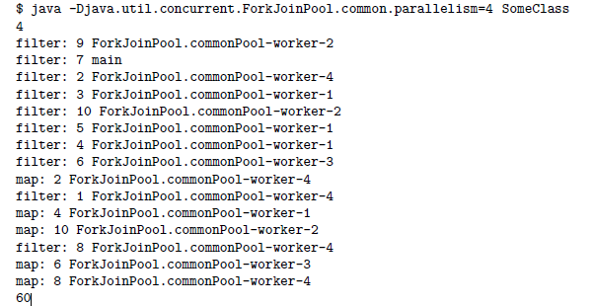
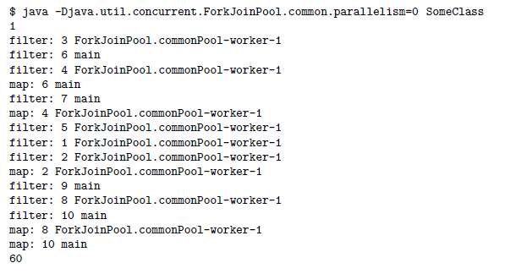
Answer
Parallelism = 4
Parallelism = 0

Slide 7
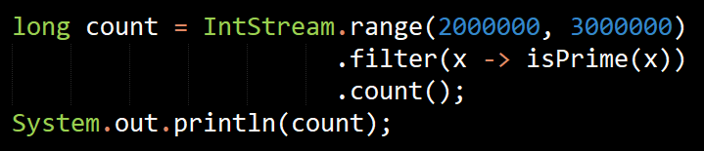
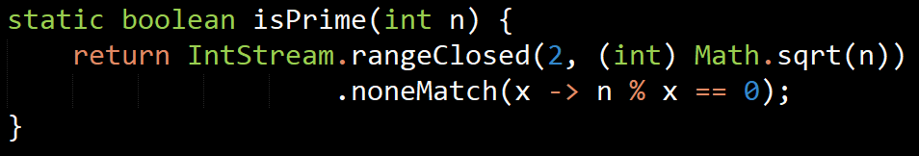
3: Primes
The following program fragment counts the number of primes between 2,000,000 and 3,000,000:
(a) Include the isPrime method and run the program. Without having to parallelize the stream, try to obtain the output after a reasonable amount of waiting time.

Slide 8
3. Primes
You can measure the time it takes to run the program by using the Instant.now and Duration.between methods. Find out how long your program takes to find all 67883 primes.
Parallelize the stream and observe how long it takes.
You should notice a significant speedup.
Notice that the isPrime method can be parallelized since determining primes are independent from one another. Find out how much time it takes to run the program. What can you conclude?
Parallelizing the isPrime method slows down the computation, possibly making it even slower than the sequential version. There is a overhead involved in parallelization and hence simple tasks should be done sequentially to avoid the overhead.
Notes:
Learning point: Parallelizing does not always equal faster methods!
When a low amount of computation is done (for example, finding all prime numbers for numbers < 20), not parallelizing will likely be faster due to the overhead cost. Don’t always parallelize.
This will become more important in the next lab: Matrix multiplication

Slide 9

4. Parallelizing side effects
What is the output of the following stream pipeline?
Running this sequentially gives us 26:
((((0 * 2 + 1) * 2 + 2) * 2 + 3) * 2 + 4)
What happens if we parallelize the stream? Explain.
Depends. There are many possible outputs.
The above stream cannot be parallelized because 2 * result + x is not associative,
i.e. the order of reduction matters.

